Slide 1
Chapter 3

Slide 2
Outline
Process Architecture
Memory Architecture
Monitor
Message Passing

Slide 3
Kinds of Architectures
SISD (Uniprocessor)
Single instruction stream
Single data stream
SIMD (Vector)
Single instruction
Multiple data
MIMD (Multiprocessors)
Multiple instruction
Multiple data.
Notes:
You can classify processors by how they manage data and instruction streams. A single-instruction single-data stream architecture is just a uniprocessor. A few years ago, single-instruction multiple-data stream architectures were popular, for example the Connection Machine CM2. These have fallen out of favor, at least for the time being.

Slide 4
Kinds of Architectures
SISD (Uniprocessor)
Single instruction stream
Single data stream
SIMD (Vector)
Single instruction
Multiple data
MIMD (Multiprocessors)
Multiple instruction
Multiple data.
Our space
(1)
Notes:
Instead, most modern multiprocessors provide multiple instruction streams, meaning that processors execute independent sequences of instructions, and multiple data streams, meaning that processors issue independent sequences of memory reads and writes. Such architectures are usually called ``MIMD''.

Slide 5
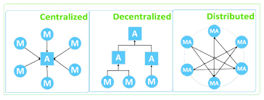
Centralized and Decentralized Architecture

Slide 6
MIMD Architectures
memory
Shared Bus
Distributed
Notes:
There are two basic kinds of MIMD architectures. In a shared bus architecture, processors and memory are connected by a shared broadcast medium called a bus (like a tiny Ethernet). Both the processors and the memory controller can broadcast on the bus. Only one processor (or memory) can broadcast on the bus at a time, but all processors (and memory) can listen. Bus-based architectures are the most common today because they are easy to build.
The principal things that affect performance are (1) contention for the memory: not all the processors can usually get at the same memory location at the same times, and if they try, they will have to queue up, (2) contention for the communication medium. If everyone wants to communicate at the same time, or to the same processor, then the processors will have to wait for one another. Finally, there is a growing communication latency, the time it takes for a processor to communicate with memory or with another processor.

Slide 7
Memory Architecture
Massage passing (send- receive) – for local memories stucture
Shared memory (read-write)
1- Memory Contention
2- Communication Contention
3- Communication Latency

Slide 8
Memory consistency
Assume that the following case occurs:^{[2]}
The memory object x=0 is replicated on memories A and B
P1 writes to x makes it x=1 to memory A
Then P2 reads x from memory B
The consistency model determines whether P2 will definitely see the write performed by P1, will definitely not, or cannot depend on seeing the write.

Slide 9
Your Server: The Shared Memory Multiprocessor (Cache)
cache
cache
cache
Bus
Bus
shared memory
9
Notes:
9
And we had expensive multiprocessor chips in the enterprise, that is, in server farms, high performance computing centers and so on. The
Shared memory multiprocessor (SMP) consists of multiple CPUs connected by a bus or interconnect network to a shared memory.

Slide 10
Cache
It is a type of volatile memory that also provides high-speed data access and exchange to the processor.
They also are helpful in storing computer programs, applications, and data with information.
The speed depends on the closeness and size of the cache.

Slide 11
Cache
Advantages: Faster & Smaller
Disadvantages: temporary (like RAM) & write update.

Slide 12
Bus-Based Architectures
cache
cache
cache
Bus
memory
Notes:
We are going to do yet another review of multiprocessor architecture.

Slide 13
Processor Issues Load Request
cache
cache
cache
Bus
memory
data
Notes:
Here is one thing that can happen when a processor issues a load request.

Slide 14
Processor Issues Load Request
Gimme
data
cache
cache
cache
Bus
Bus
memory
data
Notes:
It broadcasts a message asking for the data it needs. Notice that while it is broadcasting, no one else can use the bus.

Slide 15
Memory Responds
cache
cache
cache
Bus
Bus
Got your data right here
memory
data
data
Notes:
In this case, the memory responds to the request, also over the bus.

Slide 16
Processor Issues Load Request
Gimme
data
data
cache
cache
Bus
memory
data
Notes:
Now suppose another processor issues a load request for the same data.

Slide 17
Processor Issues Load Request
Gimme
data
data
cache
cache
Bus
Bus
memory
data
Notes:
It broadcasts its request over the bus.

Slide 18
Processor Issues Load Request
I got data
data
cache
cache
Bus
Bus
memory
data
Notes:
This time, however, the request is picked up by the first processor, which has the data in its cache. Usually, when a processor has the data cached, it, rather than the memory, will respond to load requests.

Slide 19
Other Processor Responds
I got data
data
data
cache
cache
Bus
Bus
memory
data
Notes:
The processor puts the data on the bus.

Slide 20
Other Processor Responds
data
data
cache
cache
Bus
Bus
memory
data
Notes:
Now both processors have the same data cached.

Slide 21
Modify Cached Data
data
data
cache
Bus
memory
data
(1)
Notes:
Now what happens if the red processor decides to modify the cached data?

Slide 22
Modify Cached Data
data
data
data
cache
Bus
memory
data
(1)
Notes:
It changes the copy in its cache (from blue to white).

Slide 23
Modify Cached Data
data
data
cache
Bus
memory
data

Slide 24
Modify Cached Data
data
data
cache
Bus
What’s up with the other copies?
memory
data
Notes:
Now we have a problem. The data cached at the red processor disagrees with the same copy of that memory location stored both at the other processors and in the memory itself.

Slide 25
Cache Coherence
We have lots of copies of data
Original copy in memory
Cached copies at processors
Some processor modifies its own copy
What do we do with the others?
How to avoid confusion?
Write-Back or Invalidation
Notes:
The problem of keeping track of multiple copies of the same data is called the cache coherence problem, and ways to accomplish it are called cache coherence protocols.

Slide 26
MESSAGE PASSING
Send (destination, message)
Receive (source, message)
Blocking send, blocking receive
Non blocking send, blocking receive
Non blocking send, non blocking receive

Slide 27

Addressing
one-to-one relationship
many-to-one relationship
one-to-many relationship
many-to-many relationship

Slide 28
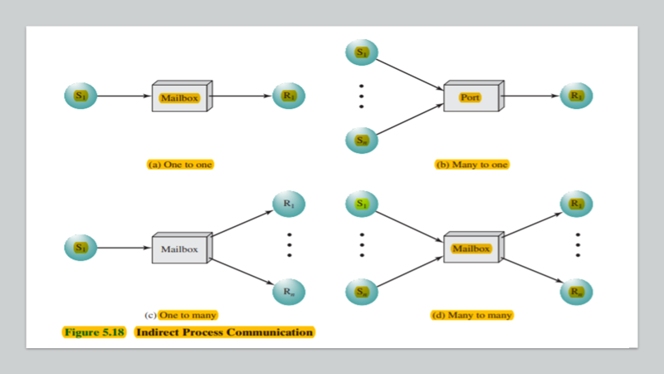

Slide 29
Message Format
The message is divided into two parts:
• a header, which contains information about the message • and a body, which contains the actual contents of the message

Slide 30
MONITORS
Accessing local data only by monitor’s procedures
A process enters monitor by invoking its procedures
Only one process executing at time the others wait

Slide 31
cwait(c) : Suspend execution of the calling process on condition c . The monitor is now available for use by another process. • csignal(c) : Resume execution of some process blocked after a cwait on the same condition.

Slide 32

READERS/WRITERS PROBLEM
A classical Reader-Writer Problem is a situation where a data structure can be read and modified simultaneously by concurrent threads.
Only one writer is allowed access the critical area at any moment in time. When there is an active Writer all readers and other writer wait until it finishes.
When no writer is active any number of readers can access the critical area.

Slide 33

Readers Have Priority
Upon receiving a reader
If there are an active writers, readers have to wait.
Otherwise, this reader can read (possibly along with other readers)
When the last reader finishes, if there are waiting writers, it must wake one of them up.

Slide 34

Writers Have Priority
If there are an active readers or writers, this writer has to wait (everyone has to finish before writer can update database)
Otherwise, this writer can write (and has exclusive access to database)
When the writer finishes, if there are waiting writers, it must wake one up (writers have priority). (second choice) if there are waiting readers, it must wake one up

